Slide 1
Grant Issues: Informatics
Ran Li
8-5-22
Issues: #3, #5

Slide 2
Overview
Introduction to our infrastructure work at SALURBAL
Insights from the experience so far

Slide 3
SALURBAL: what we wanted to do
BR
BRR
MX
MX
CL
CL
PE
PE
Input:
raw data (census/survey…ETC) from 11 countries in Latin-America
Output:
Harmonized datasets from which we can do analysis that spans across countries

Slide 4
SALURBAL: What we did
Mortality (Jane)
Methodology was excellent across working groups
Lack of infrastructure standards across working groups: data format, variable naming conventions, codebook format, codebook content, file structures…
Income (Jeff)
Health (James)

Slide 5
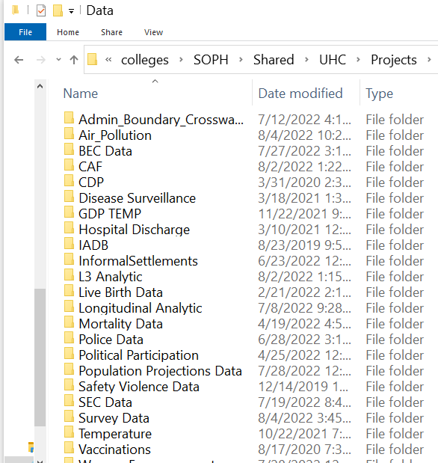
SALURBAL: What we did
Mortality (Jane)
Methodology was excellent across working groups
Lack of infrastructure standards across working groups: data format, variable naming conventions, codebook format, codebook content, file structures…
The final output was stored in separate folders created by each working group
This was the informatics infrastructure Years 1-4.
Lack of structure and accessibility created bottlenecks
Income (Jeff)
Health (James)

Slide 6

🤕 #1 Lack of transparency to data available
What data is available?
Do I have to click every folder individually and check every data file?
Users
(researchers)

Slide 7

🤕 #2 Data access is inefficient
Mortality (Jane)
Can I have income and mortality data?
Income (Jeff)
Health (James)
SALURBAL
(staff)
Users
(researchers)

Slide 8
🤕 #2 Data access is inefficient
Mortality (Jane)
Manually pull income data
Manually pull mortality data
Manually pull income metadata
Manually pull mortality metadata
Manually wrangle and merge data
Manually wrangle and metadata
Manually QC
Manually send merged data to user
Income (Jeff)
Health (James)
SALURBAL
(staff)
Users
(researchers)

Slide 9
If data was in one data structure… I could:
Automate enforcement of FAIR standards
Systematic QC checks
Automate with data distribution
Parameterized reports
ETC
🤕 #3 No big picture
Mortality (Jane)
Income (Jeff)
Health (James)
SALURBAL
(staff)

Slide 10
SALURBAL: what are doing now
Mortality (Jane)
Design a SALURBAL wide informatics standard (variable naming, data format, metadata format) applied at the work group level.
Income (Jeff)
Health (James)

Slide 11
SALURBAL: what are doing now
Mortality (Jane)
Design a SALURBAL wide informatics standard (variable naming, data format, metadata format) applied at the work group level.
Build a unified dataset with automated testing to enforce strict standards
Income (Jeff)
Health (James)

Slide 12


SALURBAL: what are doing now
Mortality (Jane)
Design a SALURBAL wide informatics standard (variable naming, data format, metadata format) applied at the work group level.
Build a unified dataset with automated testing to enforce strict standards
Create a user-friendly data portal to access/download data, metadata and reproject outputs.
Income (Jeff)
Health (James)

Slide 13
Insights
Informatics infrastructure matters! Its possible that your methodology and statistics are excellent, but your project may still be hampered by informatics bottlenecks.
Much easier to enforce standards at start. Post-hoc standardization is messy.
Automate when ever possible. Standards (FAIR or others) are only useful when enforced. A practical way is to automate at all steps of the data pipeline (intake, transformation, database loading, data distribution and dissemination) and codify standards into the automation process.
Web accessible. Building a web application for internal use will allow us to not only monitor, report and access data pipeline progress but also to remove the need to give access to secure storage accounts.

